Slide 1
AMD and DME classification from OCT images Adeel Ahmed

Slide 2
Agenda
To develop a classification system that could identify retinal information through OCT images.
To identify the disease by scanning images of AMD, DME affected and normal patients.
The system will be able to classify images at patient level using CNNs.
To help doctors and experts in identification of maculopathy at early stage in a much
speedy way than previously used CADs

Slide 3
Problem Statement and Assumptions
To design a system for the identification and classification of OCT Scans of patients suffering from Age-Related Macular Degeneration (AMD) and Diabetic Macular Edema (DME) from Normal Patients.
A set of OCT image and corresponding labels {𝑛𝑜𝑟𝑚𝑎𝑙,𝐴𝑀𝐷,𝐷𝑀𝐸})are needed as training data. As the adopted VGG16 is designed for 224 × 224 images with three channels (color images), all OCT images are preprocessed (𝐼∈ℝ224×224)

Slide 4
Insights from the Data
The Dataset contains 3 classes (AMD,DME and Normal)
Number of images: 3231
The Data is balanced (contains almost equal number of images for each class)

Slide 5
Data Preprocessing Steps
For custom CNN:
Resized to 128x128 (Greyscale)
Normalized Data
converted class labels to on-hot encoding
Shuffled the dataset with random state=2
Split the dataset with 20% testing data
For Transfer Learning with VGG19
Resized to 224x224

Slide 6
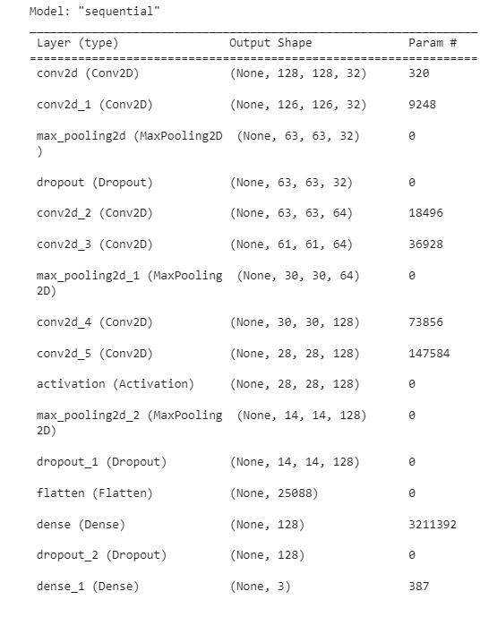
Algorithms used for Modeling
Used the following custom CNN and achieved 100% accuracy on training the original data
Learning Rate=0.0001
Optimizer=Adam
Batch Size=24
Epochs=20

Slide 7
Algorithms used for Modeling
Used VGG19 with transfer learning and achieved 99.7% accuracy
Loss=categorical cross entropy
Optimizer=Adam
Epochs=20

Slide 8

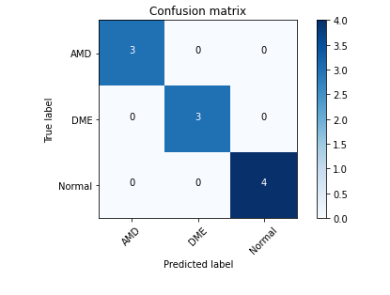
Custom CNN Results
Accuracy
Confusion Matrix using a sample size=10

Slide 9

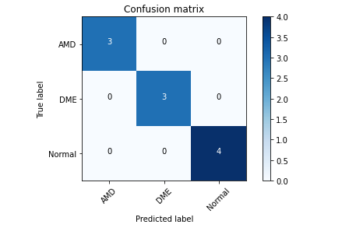
Transfer Learning Results
Accuracy
Confusion Matrix using a sample size=10

